Slide 1
Better Links stronger communities laois’ story

Slide 2
Hello!
I am Ann-Marie Kelly
I am here to tell you about what we do in Laois
You can find me at amkelly@laoiscoco.ie

Slide 3
The world of environment awareness officers
All EAOs working throughout the country.
Other Stakeholders including Government Departments
Environment Protection Agency
Non Governmental Organisations
Partnership Companies
Community Groups & Schools
As you’d expect, this is not an exhaustive list - we firmly believe it is good to talk!
Better Links Stronger Communities
Organising committee
Meath: Bernadine Carry
South Dublin: Sorcha O’Brien
Westmeath : Ruth Maxwell
Kildare: Dara Wyer
Longford : Gary Brady
Dublin City : Fionnghuala Ryan
Dun Laoghaire Rathdown: – Martha Casserly
Laois – yours truly!

Slide 4
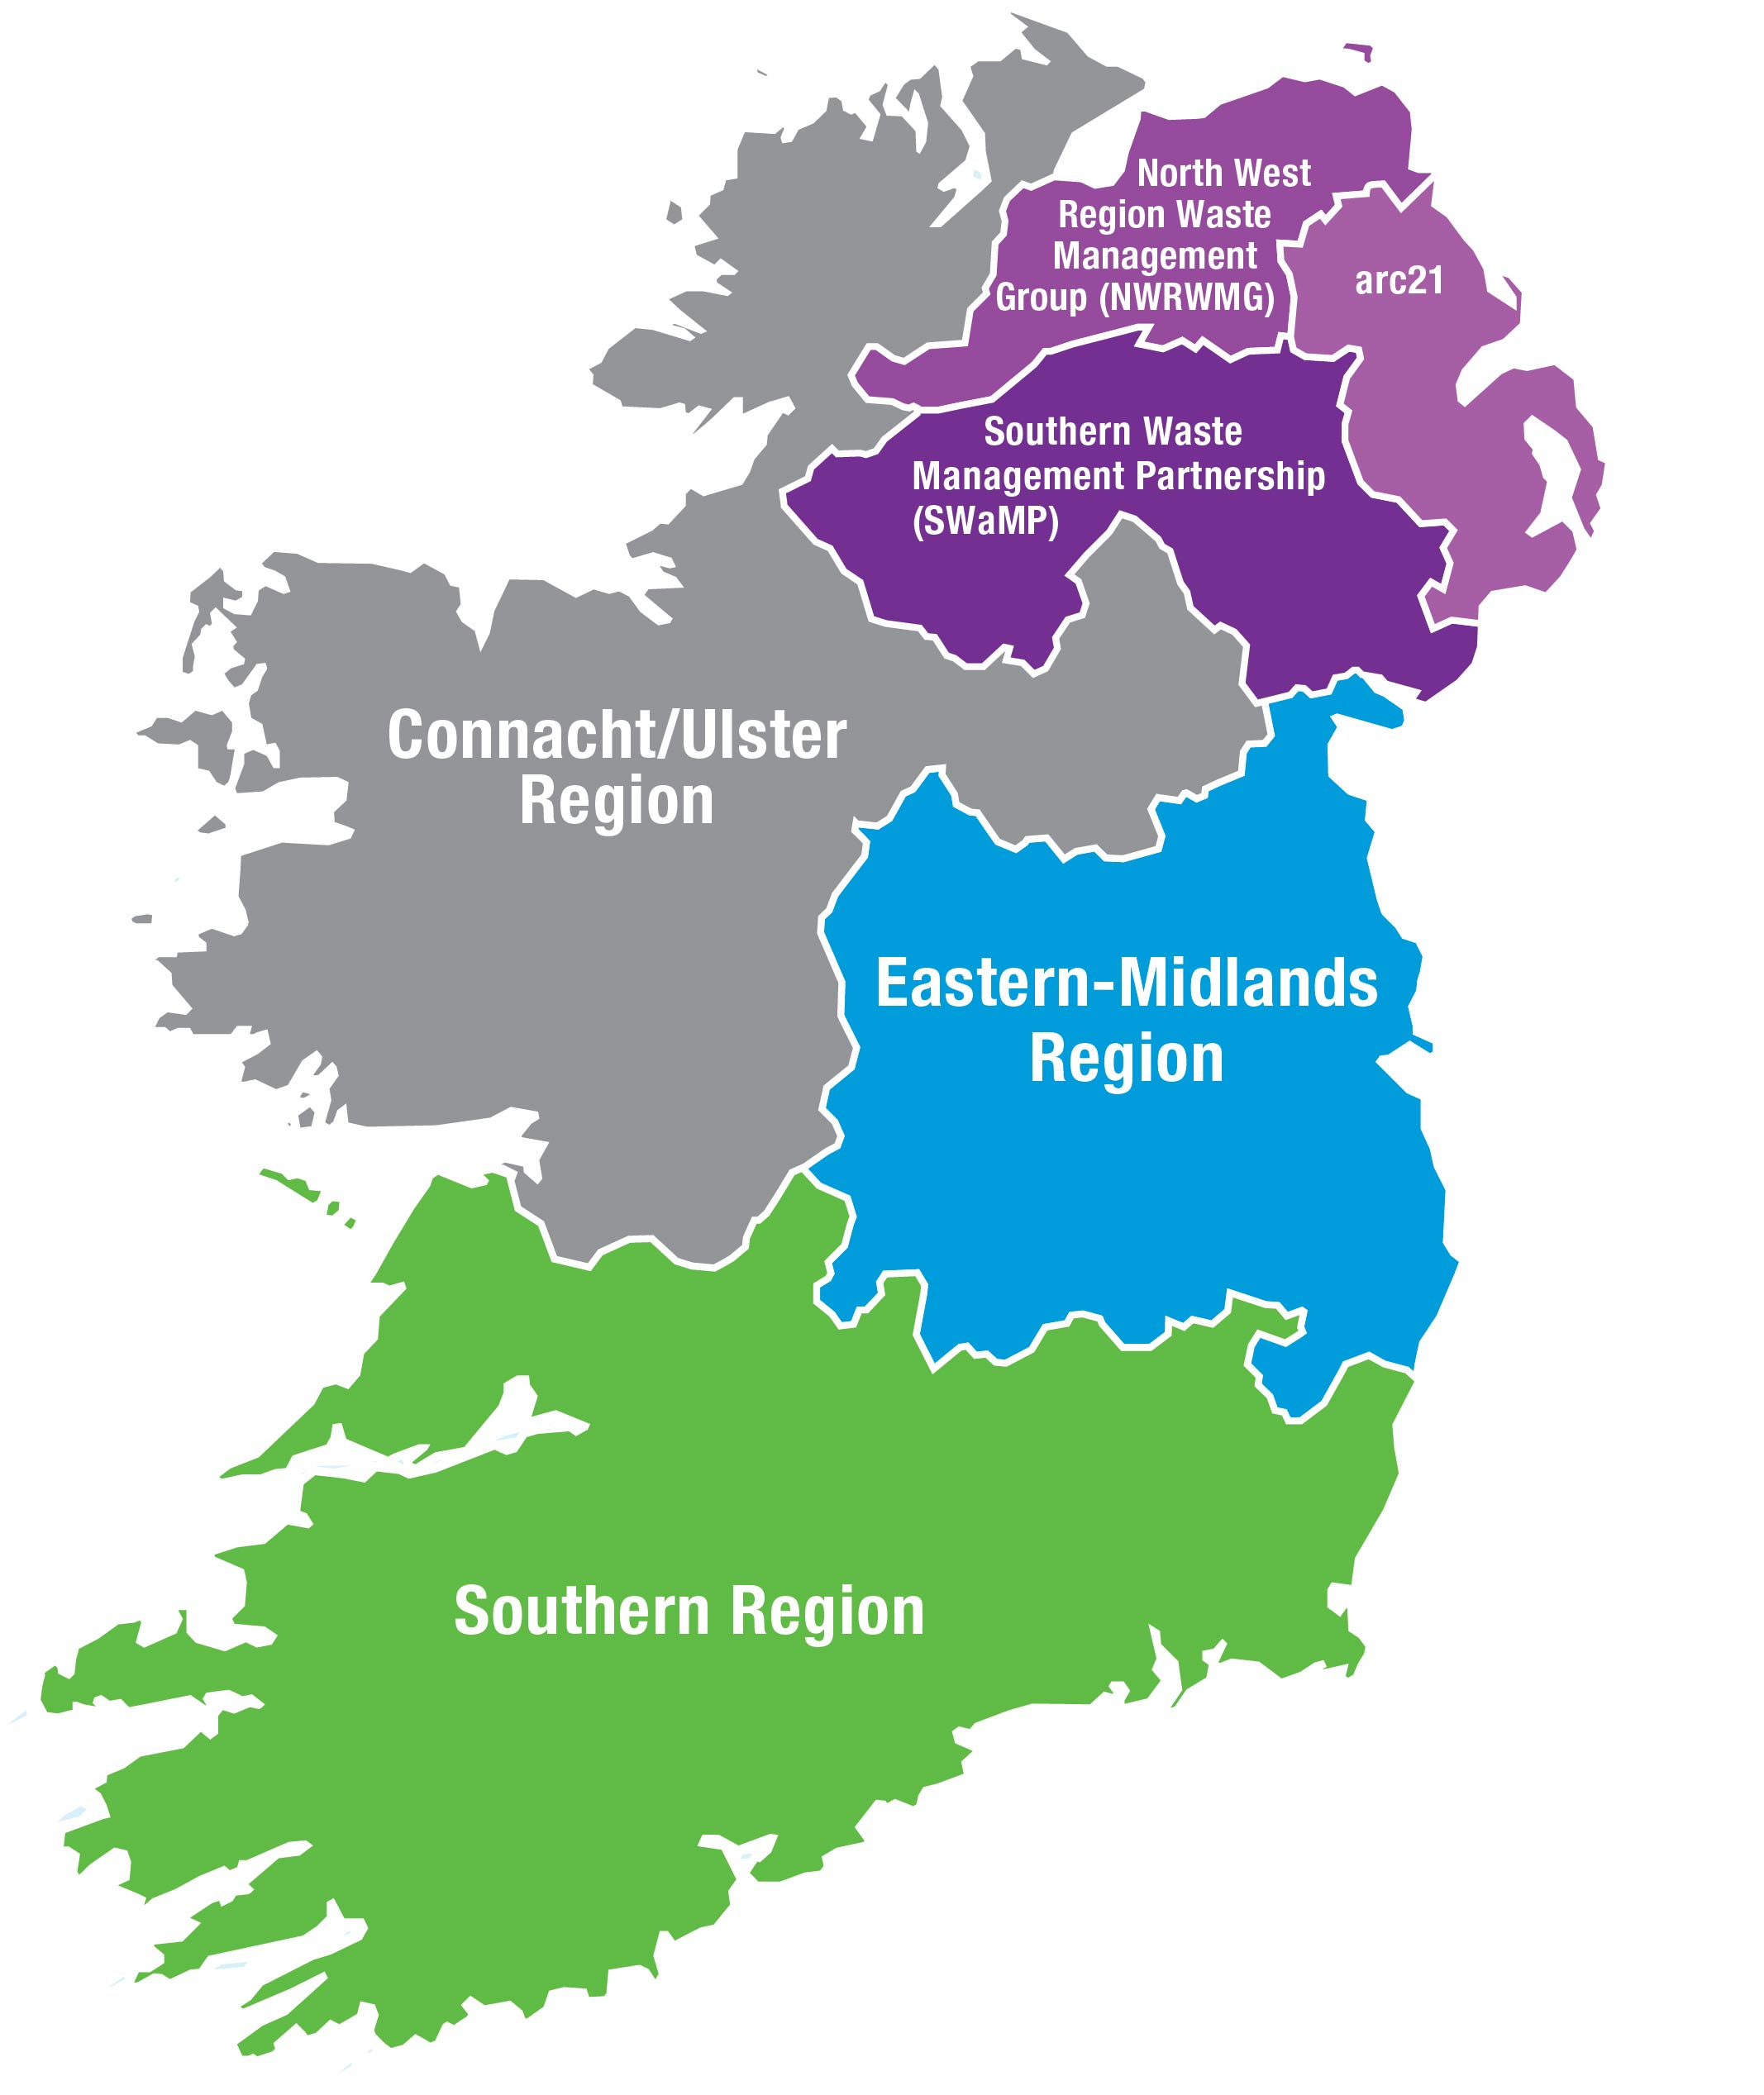
Waste Management Planning (2015-2021)
Connacht / Ulster Region 9 LAs Cavan, Donegal, Galway Co and Galway City, Leitrim, Mayo, Monaghan, Roscommon and Sligo
Eastern Midlands Waste Region Laois, Offaly, Westmeath, Longford, Louth, Meath, Kildare, Dublin City, South Dublin, Dun Laoghaire Rathdown, Fingal and Wicklow
Southern Region - 10 LAs Carlow, Clare, Cork City, Cork Co, Limerick City and County, Kerry, Kilkenny, Tipperary, Waterford City and County and Wexford

Slide 5
Regional Waste Management Plan Targets
No 1:
We aim to achieve a 1% reduction per annum in the quality of household waste generated per capita over the period of the Eastern Midlands Region Waste Management plan.
No 2:
Reduce to 0% the direct disposal of unprocessed municipal waste to landfill (from 2016 onwards) in favour of higher value pre-treatment processes and indigenous recovery practices.
No 3:
We aim to achieve a recycling rate of 50% of managed municipal waste by 2020..
* Municipal waste is classified as everyday waste discarded by the public i.e. Rubbish !

Slide 6
How to achieve these targets??

Slide 7
OUR CONCEPT
By establishing new and strengthening existing working relationship links, we acheive stronger and more resilient communities.

Slide 8
“A community is defined as a group of people living in the same place or having a particular characteristic in common”

Slide 9
Our Community
The Environment Awareness Officer networks and interacts with communities in a variety of ways:
Tidy Towns network
Schools – Green Schools (An Taisce); Young Environmentalist Award (Eco Unesco)
Interest groups e.g. IWT, Bird Watch Ireland, Mens sheds,
Facilitate workshops in local libraries etc.
Social media notifications; Cinema, radio and billboard advertising
Administer LA21 Grants and other Grant schemes
Deliver national projects at local level e.g. Reuse Month in October
Special projects e.g. in association with CTC/LAPN or LAWCO office / Town and Village Scheme / Entente Florale Europe

Slide 10
Beside community groups, we work
with Elected Representatives on a variety of topics and events – annual and one off events eg WEEE, HHW, Spring Clean, Reuse Month
with Litter wardens and Enforcement Officers
and on anti dumping initiatives – funded by the DCCAE
Contact your local EAO with your project ideas and/or to find out how to get involved in projects happening in your area.

Slide 11
Town and Village renewal scheme Department of rural and community development:
Central aim: to support the revitalisation of towns and villages in order to improve the living and working environment of their communities and increase their potential to support increased economic activity into the future.
Department of Rural and Community Development (administered by relevant Local Authority)
Annual, competitive project: Expressions of interest – Competitive Bid
Contact your Local Authority Town & Village Scheme coordinator
2018 fund: €21.3m (Laois secured €872K – 12 projects)
2017 fund: € 21.6m (Laois secured €983K – 11 projects)
2016 fund: Newly Established (Each LA secured €380K)

Slide 12
Previously funded ideas – www.drcd.gov.ie
Village Enhancement Schemes / Public Realm Enhancement
Developing community gardens / fit out of centres
Development of an enterprise hub
Refurbishment works to existing community facilities
Pathway linking village to local greenway

Slide 13
Entente Florale Europe – Abbeyleix Tidy Towns
Asked by the national Tidy Towns Unit to be one of 2 locations to represent Ireland in 2017.
Huge community engagement and effort required.
Focus on set criteria, produce portfolio on the town as well as hosting European judges in July 2017. Awards in September 2017

Slide 14
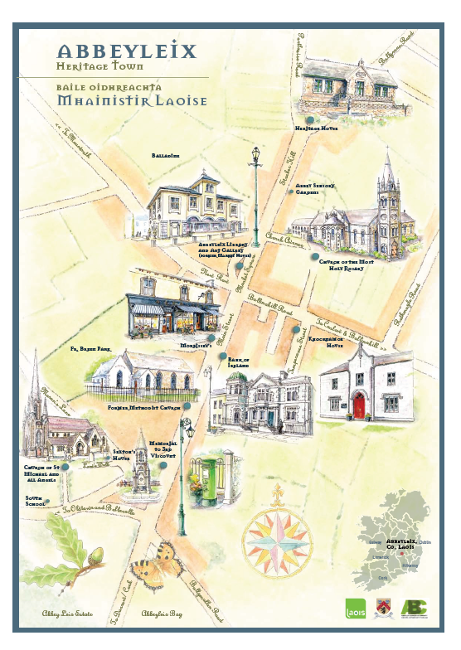
Entente Florale Europe – Abbeyleix Tidy Towns
Entente Florale Europe was a highlight; a true illustration of people coming together for the benefit of the wider community.
If you get an opportunity to participate in it do, but be prepared for a lot of additional demands on your time and hard work!

Slide 15
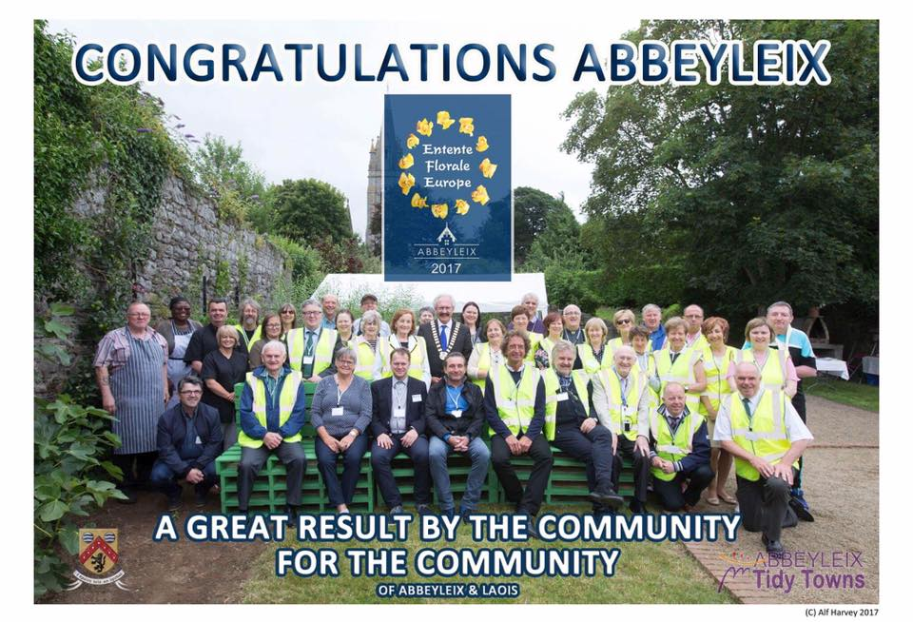
Abbeyleix achieved Silver Award
and the
President’s Prize for Biodiversity – for Abbeyleix Bog Project

Slide 16
Final thoughts ...

Slide 17
Thanks!
Any questions?
You can find me at amkelly@laoiscoco.ie or
Alternatively contact the Environment Awareness Officer in your own Local Authority Area. just tell them Ann-Marie in Laois sent you!

